Slide 1
Artificial Neural Networks

Slide 2
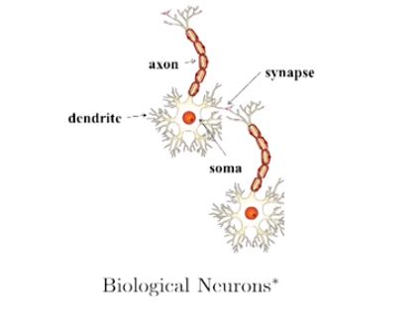
Review
Dendrite: Receives signals from other neurons.
Synapse: Point of connection to other neurons.
Soma: Processes the information.
Axon: Transmits the output of this neuron.

Slide 3
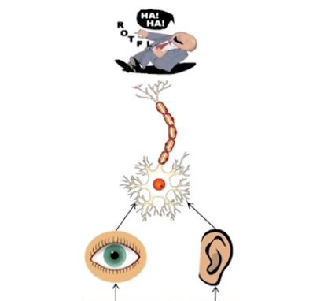

Let’s see an illustration of how a neuron works.
Our sense organs interact with the outside world.
They relay information to the neurons.
The neurons (may) get activated and produces a response. (Laughter in this case)
In reality, it is not just a single neuron which does all this.

Slide 4
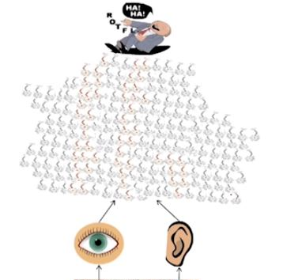

There is a massively parallel interconnected network of neurons.
The sense organs relay information to the lowest layer of neurons.
Some of these neurons may fir in response to this information and in turn relay information to other neurons they are connected to.
These neurons may also fire and the process continues eventually resulting in a response (laughter in this case).
An average brain has around 100 billion neurons!

Slide 5
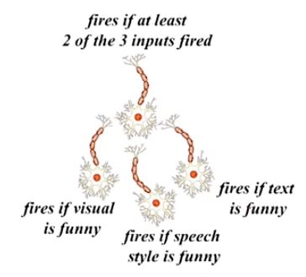
This massively parallel network also ensures that there is division of work.
Each neuron may perform a certain role or respond to certain stimulus.

Slide 6
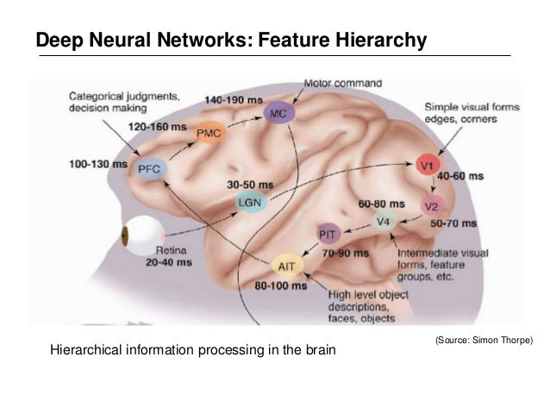
The neurons in the brain are arranged in a hierarchy.
We illustrate this with the help of visual cortex which deals with processing visual information.
Starting from retina, the information is relayed to several layers (follow the arrows)
We observe that layers V1, V2 to AIT form a hierarchy (from identifying simple visual forms to high level objects.)

Slide 7
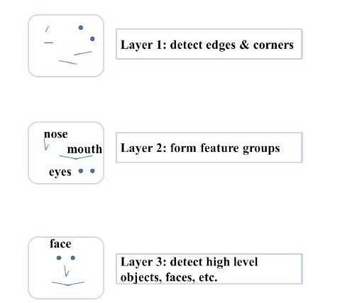
Note: This is an over-simplified explanation of how a brain works.

Slide 8
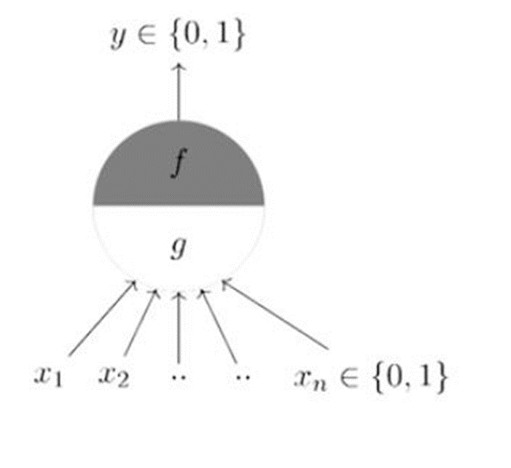
McCulloch Pitts Neuron
McCulloch (Neuroscientist) and Pitts (logician) proposed a highly simplified computational model of the neuron (1943).
It may be divided into 2 parts. The first part, g takes an input (dendrite), performs an aggregation and based on the aggregated value the second part, f makes a decision.
Lets suppose that I want to predict my own decision, whether to watch a random cricket game or not on TV. The inputs are all Boolean i.e., {0,1} and my output variable is also Boolean {0: Will watch it, 1: Won’t watch it}.
So, x_1 could be isIPLOn (I like IPL more)
x_2 could be isItAFriendlyGame (I tend to care less about the friendlies)
x_3 could be isNotHome (Can’t watch it when I’m running errands. Can I?)
x_4 could be isCSKPlaying (I am a big CSK fan :P) and so on.

Slide 9

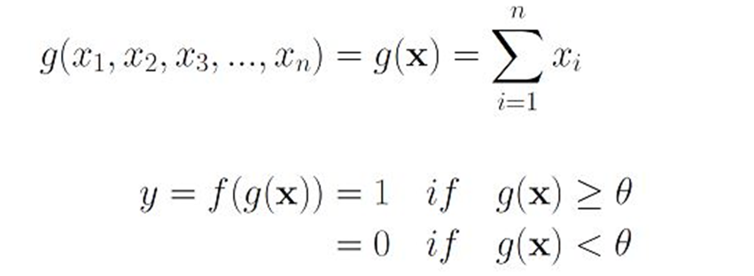
These inputs can either be excitatory or inhibitory.
Inhibitory inputs are those that have maximum effect on the decision making irrespective of other inputs i.e., if x_3 is 1 (not home) then my output will always be 0 i.e., the neuron will never fire, so x_3 is an inhibitory input.
Excitatory inputs are NOT the ones that will make the neuron fire on their own but they might fire it when combined together.
Formally, this is what is going on:

Slide 10
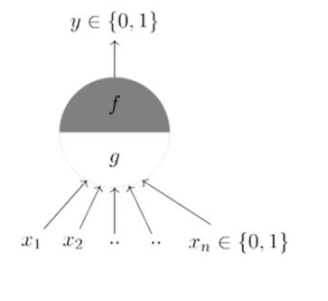
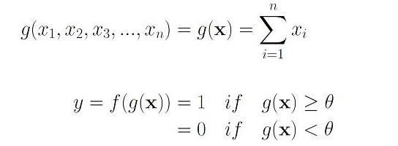
M-P neuron summary
G aggregates the inputs and the function f takes a decision based on this aggregation.
The inputs can be excitatory or inhibitory.
y = 0 if any x_{i} is inhibitory, else
Θ is called as Thresholding parameter.
This is called thresholding logic.

Slide 11
Boolean functions using M-P neuron
Lets look at how this neuron can be used to represent a few Boolean functions.
Mind you that our inputs are all Boolean and the output is also Boolean so essentially, the neuron is just trying to learn a Boolean function.
A lot of Boolean decision problems can be cast into this, based on appropriate input variables— like whether to continue attending my lectures, whether to watch Friends after reading this lecture etc. can be represented by the M-P neuron.

Slide 12
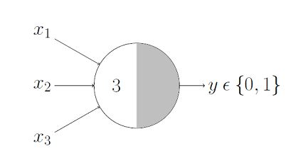
AND Function
An AND function neuron would only fire when ALL the inputs are ON i.e., g(x) ≥ 3 here.

Slide 13
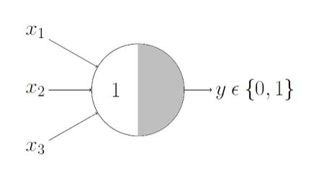
OR Function
This is self explanatory as we know that an OR function neuron would fire if ANY of the inputs is ON i.e., g(x) ≥ 1 here.

Slide 14
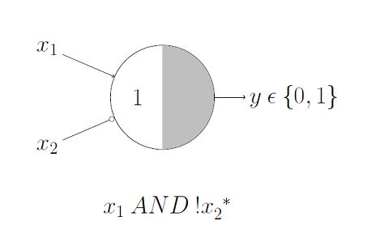
A Function With An Inhibitory Input
Here, we have an inhibitory input i.e., x₂ so whenever x₂ is 1, the output will be 0.
Keeping that in mind, we know that x₁ AND !x₂ would output 1 only when x₁ is 1 and x₂ is 0 so it is obvious that the threshold parameter should be 1.
Lets verify that, the g(x) i.e., x₁ + x₂ would be ≥ 1 in only 3 cases:
Case 1: when x₁ is 1 and x₂ is 0 Case 2: when x₁ is 1 and x₂ is 1 Case 3: when x₁ is 0 and x₂ is 1
But in both Case 2 and Case 3, we know that the output will be 0 because x₂is 1 in both of them, thanks to the inhibition. And we also know that x₁ AND !x₂ would output 1 for Case 1 (above) so our thresholding parameter holds good for the given function.

Slide 15
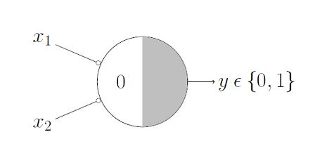
NOR Function
For a NOR neuron to fire, we want ALL the inputs to be 0 so the thresholding parameter should also be 0 and we take them all as inhibitory input.

Slide 16
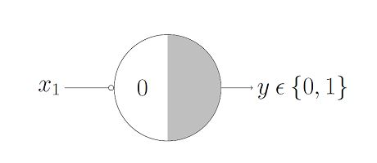
NOT Function
For a NOT neuron, 1 outputs 0 and 0 outputs 1. So we take the input as an inhibitory input and set the thresholding parameter to 0.

Slide 17
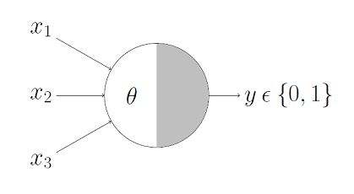
M-P neuron concise representation
This representation denotes that, for the Boolean inputs x₁, x₂ and x₃ if the g(x) i.e., sum ≥ theta, the neuron will fire otherwise, it won’t.

Slide 18
Geometric Interpretation Of M-P Neuron
OR Function
We already discussed that the OR function’s thresholding parameter theta is 1.

Slide 19
Geometric Interpretation Of M-P Neuron
OR Function
We already discussed that the OR function’s thresholding parameter theta is 1.
The inputs are Boolean, so only 4 combinations are possible — (0,0), (0,1), (1,0) and (1,1).

Slide 20
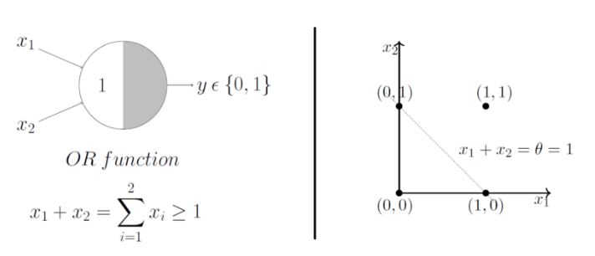
Geometric Interpretation Of M-P Neuron
OR Function
We already discussed that the OR function’s thresholding parameter theta is 1.
The inputs are Boolean, so only 4 combinations are possible — (0,0), (0,1), (1,0) and (1,1).

Slide 21
Geometric Interpretation Of M-P Neuron
OR Function
We already discussed that the OR function’s thresholding parameter theta is 1.
The inputs are Boolean, so only 4 combinations are possible — (0,0), (0,1), (1,0) and (1,1).
Now plotting them on a 2D graph and making use of the OR function’s aggregation equation i.e., x₁ + x₂ ≥ 1 using which we can draw the decision boundary as shown in the graph below.

Slide 22
Geometric Interpretation Of M-P Neuron
OR Function
We already discussed that the OR function’s thresholding parameter theta is 1.
The inputs are Boolean, so only 4 combinations are possible — (0,0), (0,1), (1,0) and (1,1).
Now plotting them on a 2D graph and making use of the OR function’s aggregation equation i.e., x₁ + x₂ ≥ 1 using which we can draw the decision boundary as shown in the graph below.
Note that this is not a real number graph.

Slide 23
We just used the aggregation equation i.e., x₁ + x₂ =1 to graphically show that all those inputs whose output when passed through the OR function M-P neuron lie ON or ABOVE that line and all the input points that lie BELOW that line are going to output 0.

Slide 24
We just used the aggregation equation i.e., x₁ + x₂ =1 to graphically show that all those inputs whose output when passed through the OR function M-P neuron lie ON or ABOVE that line and all the input points that lie BELOW that line are going to output 0.
Voila!! The M-P neuron just learnt a linear decision boundary! The M-P neuron is splitting the input sets into two classes — positive and negative. Positive ones (which output 1) are those that lie ON or ABOVE the decision boundary and negative ones (which output 0) are those that lie BELOW the decision boundary.

Slide 25
We just used the aggregation equation i.e., x₁ + x₂ =1 to graphically show that all those inputs whose output when passed through the OR function M-P neuron lie ON or ABOVE that line and all the input points that lie BELOW that line are going to output 0.
Voila!! The M-P neuron just learnt a linear decision boundary! The M-P neuron is splitting the input sets into two classes — positive and negative. Positive ones (which output 1) are those that lie ON or ABOVE the decision boundary and negative ones (which output 0) are those that lie BELOW the decision boundary.
Lets convince ourselves that the M-P unit is doing the same for all the Boolean functions by looking at more examples (if it is not already clear from the math).

Slide 26
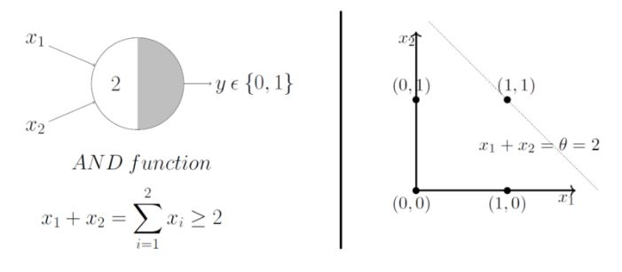
AND Function
In this case, the decision boundary equation is x₁ + x₂ = 2. Here, all the input points that lie ON or ABOVE, just (1,1), output 1 when passed through the AND function M-P neuron. It fits! The decision boundary works!

Slide 27
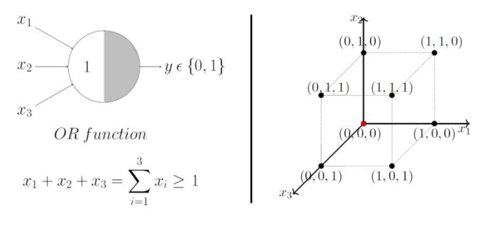
OR Function with 3 inputs
Lets just generalize this by looking at a 3 input OR function M-P unit. In this case, the possible inputs are 8 points — (0,0,0), (0,0,1), (0,1,0), (1,0,0), (1,0,1),… you got the point(s) :P
We can map these on a 3D graph and this time we draw a decision boundary in 3 dimensions.

Slide 28
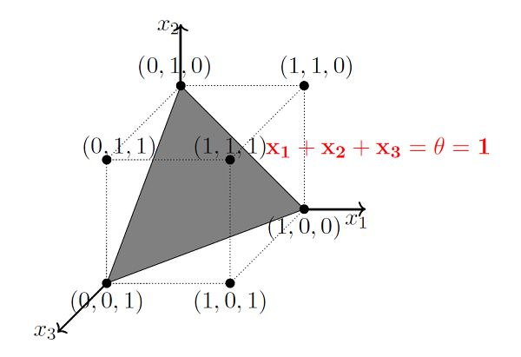
The plane that satisfies the decision boundary equation x₁ + x₂ + x₃ = 1 is shown:

Slide 29
The plane that satisfies the decision boundary equation x₁ + x₂ + x₃ = 1 is shown:
Take your time and convince yourself by looking at the plot that all the points that lie ON or ABOVE that plane (positive half space) will result in output 1 when passed through the OR function M-P unit and all the points that lie BELOW that plane (negative half space) will result in output 0.

Slide 30
The plane that satisfies the decision boundary equation x₁ + x₂ + x₃ = 1 is shown:
Take your time and convince yourself by looking at the plot that all the points that lie ON or ABOVE that plane (positive half space) will result in output 1 when passed through the OR function M-P unit and all the points that lie BELOW that plane (negative half space) will result in output 0.
Just by hand coding a thresholding parameter, M-P neuron is able to conveniently represent the Boolean functions which are linearly separable.

Slide 31
The plane that satisfies the decision boundary equation x₁ + x₂ + x₃ = 1 is shown:
Take your time and convince yourself by looking at the plot that all the points that lie ON or ABOVE that plane (positive half space) will result in output 1 when passed through the OR function M-P unit and all the points that lie BELOW that plane (negative half space) will result in output 0.
Just by hand coding a thresholding parameter, M-P neuron is able to conveniently represent the Boolean functions which are linearly separable.
Linear separability (for Boolean functions): There exists a line (plane) such that all inputs which produce a 1 lie on one side of the line (plane) and all inputs which produce a 0 lie on other side of the line (plane).

Slide 32
Limitations Of M-P Neuron
What about non-Boolean (say, real) inputs?
Do we always need to hand code the threshold?
Are all inputs equal? What if we want to assign more importance to some inputs?
What about functions which are not linearly separable? Say XOR function.

Slide 33
Perceptron
Overcoming the limitations of the M-P neuron, Frank Rosenblatt, an American psychologist, proposed the classical Perceptron model, the mighty artificial neuron, in 1958.

Slide 34
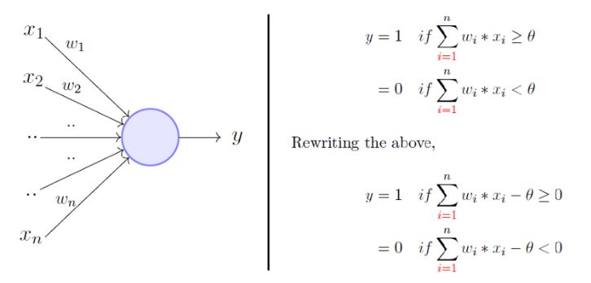
Perceptron
Overcoming the limitations of the M-P neuron, Frank Rosenblatt, an American psychologist, proposed the classical Perceptron model, the mighty artificial neuron, in 1958.

Slide 35
Perceptron
Overcoming the limitations of the M-P neuron, Frank Rosenblatt, an American psychologist, proposed the classical Perceptron model, the mighty artificial neuron, in 1958.
It is more generalized computational model than the McCulloch-Pitts neuron where weights and thresholds can be learnt over time.

Slide 36
Perceptron
Overcoming the limitations of the M-P neuron, Frank Rosenblatt, an American psychologist, proposed the classical Perceptron model, the mighty artificial neuron, in 1958.
It is more generalized computational model than the McCulloch-Pitts neuron where weights and thresholds can be learnt over time.
Main differences: Introduction of numerical weights for inputs and a mechanism to learn these weights.

Slide 37
Perceptron
Overcoming the limitations of the M-P neuron, Frank Rosenblatt, an American psychologist, proposed the classical Perceptron model, the mighty artificial neuron, in 1958.
It is more generalized computational model than the McCulloch-Pitts neuron where weights and thresholds can be learnt over time.
Main differences: Introduction of numerical weights for inputs and a mechanism to learn these weights.
Inputs are no longer limited to Boolean values.

Slide 38
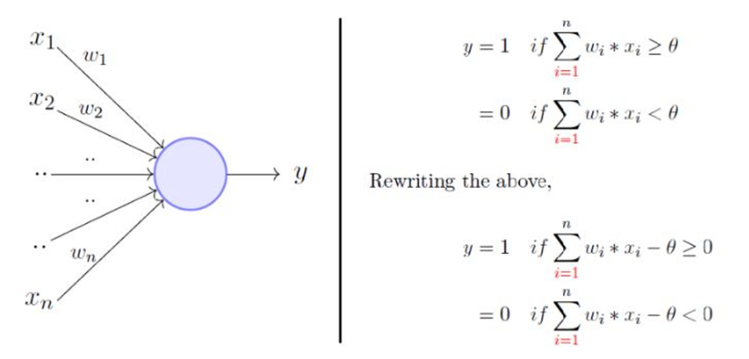
The perceptron model is a more general computational model than McCulloch-Pitts neuron. It takes an input, aggregates it (weighted sum) and returns 1 only if the aggregated sum is more than some threshold else returns 0.

Slide 39
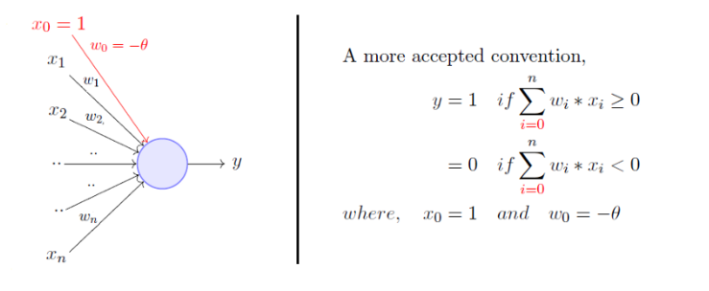
The perceptron model is a more general computational model than McCulloch-Pitts neuron. It takes an input, aggregates it (weighted sum) and returns 1 only if the aggregated sum is more than some threshold else returns 0.
Rewriting the threshold as shown above and making it a constant input with a variable weight, we will get something like this

Slide 40
We will now try to answer these questions:
Why are we trying to implement Boolean functions?
Why do we need weights?
Why is w0 = - θ called the bias?

Slide 41
Consider the task of predicting whether we would like a movie or not.

Slide 42
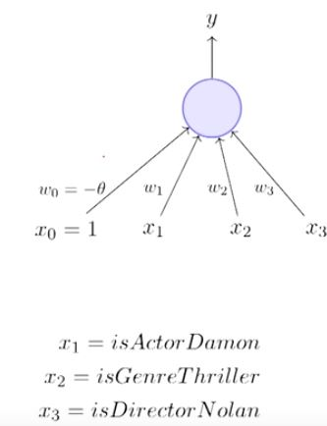
Consider the task of predicting whether we would like a movie or not.

Slide 43
Consider the task of predicting whether we would like a movie or not.
Suppose, we base our decision on 3 inputs (binary, for simplicity)

Slide 44
Consider the task of predicting whether we would like a movie or not.
Suppose, we base our decision on 3 inputs (binary, for simplicity)
Based on our past viewing experience (data), we may give a high weight to isDirectorNolan as compared to the other inputs.

Slide 45
Consider the task of predicting whether we would like a movie or not.
Suppose, we base our decision on 3 inputs (binary, for simplicity)
Based on our past viewing experience (data), we may give a high weight to isDirectorNolan as compared to the other inputs.
Specifically, even if the actor is not Matt Damon and the genre is not thriller we would still want to cross the threshold by assigning a high weight to isDirectorNolan.

Slide 46
Consider the task of predicting whether we would like a movie or not.
Suppose, we base our decision on 3 inputs (binary, for simplicity)
Based on our past viewing experience (data), we may give a high weight to isDirectorNolan as compared to the other inputs.
Specifically, even if the actor is not Matt Damon and the genre is not thriller we would still want to cross the threshold by assigning a high weight to isDirectorNolan.
w₀ is called the bias as it represents the prior (prejudice).

Slide 47
Consider the task of predicting whether we would like a movie or not.
Suppose, we base our decision on 3 inputs (binary, for simplicity)
Based on our past viewing experience (data), we may give a high weight to isDirectorNolan as compared to the other inputs.
Specifically, even if the actor is not Matt Damon and the genre is not thriller we would still want to cross the threshold by assigning a high weight to isDirectorNolan.
w₀ is called the bias as it represents the prior (prejudice).
A movie buff may have a very low threshold and may watch any movie irrespective of the genre, actor, director [θ = 0].

Slide 48
Consider the task of predicting whether we would like a movie or not.
Suppose, we base our decision on 3 inputs (binary, for simplicity)
Based on our past viewing experience (data), we may give a high weight to isDirectorNolan as compared to the other inputs.
Specifically, even if the actor is not Matt Damon and the genre is not thriller we would still want to cross the threshold by assigning a high weight to isDirectorNolan.
w₀ is called the bias as it represents the prior (prejudice).
A movie buff may have a very low threshold and may watch any movie irrespective of the genre, actor, director [θ = 0].
On the other hand, a selective viewer may only watch thrillers starring Matt Damon and directed by Nolan [θ = 3]

Slide 49
Consider the task of predicting whether we would like a movie or not.
Suppose, we base our decision on 3 inputs (binary, for simplicity)
Based on our past viewing experience (data), we may give a high weight to isDirectorNolan as compared to the other inputs.
Specifically, even if the actor is not Matt Damon and the genre is not thriller we would still want to cross the threshold by assigning a high weight to isDirectorNolan.
w₀ is called the bias as it represents the prior (prejudice).
A movie buff may have a very low threshold and may watch any movie irrespective of the genre, actor, director [θ = 0].
On the other hand, a selective viewer may only watch thrillers starring Matt Damon and directed by Nolan [θ = 3]
The weights (w₁, w₂, ..w_{n}) and the bias (w₀) will depend upon the data (viewer history in this case)

Slide 50
M-P neuron vs Perceptron

Slide 51
M-P neuron vs Perceptron
From the equations it is clear that even a perceptron separates the input space into two halves.

Slide 52
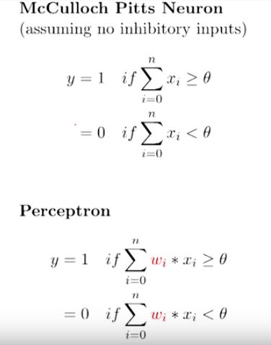
M-P neuron vs Perceptron
From the equations it is clear that even a perceptron separates the input space into two halves.

Slide 53
M-P neuron vs Perceptron
From the equations it is clear that even a perceptron separates the input space into two halves.
All inputs which produce a 1 lie on one side and all inputs which produce a 0 lie on the other side.

Slide 54
M-P neuron vs Perceptron
From the equations it is clear that even a perceptron separates the input space into two halves.
All inputs which produce a 1 lie on one side and all inputs which produce a 0 lie on the other side.
In other words, a single perceptron can only be used to implement linearly separable functions.

Slide 55
M-P neuron vs Perceptron
From the equations it is clear that even a perceptron separates the input space into two halves.
All inputs which produce a 1 lie on one side and all inputs which produce a 0 lie on the other side.
In other words, a single perceptron can only be used to implement linearly separable functions.
Then what’s the difference? The weights (including threshold) can be learned and the inputs can be real valued.

Slide 56
M-P neuron vs Perceptron
From the equations it is clear that even a perceptron separates the input space into two halves.
All inputs which produce a 1 lie on one side and all inputs which produce a 0 lie on the other side.
In other words, a single perceptron can only be used to implement linearly separable functions.
Then what’s the difference? The weights (including threshold) can be learned and the inputs can be real valued.
A single perceptron can only be used to implement linearly separable functions. It takes both real and Boolean inputs and associates a set of weights to them, along with a bias (threshold). We learn the weights, we get the function. Let's use a perceptron to learn an OR function.

Slide 57
OR Function using a Perceptron

Slide 58
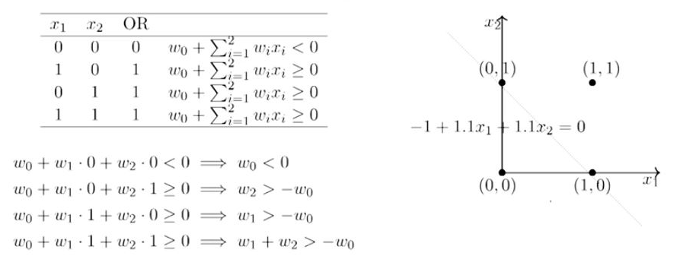
OR Function using a Perceptron

Slide 59
OR Function using a Perceptron
What’s going on above is that we defined a few conditions (the weighted sum has to be more than or equal to 0 when the output is 1) based on the OR function output for various sets of inputs, we solved for weights based on those conditions and we got a line that perfectly separates positive inputs from those of negative.

Slide 60
OR Function using a Perceptron
What’s going on above is that we defined a few conditions (the weighted sum has to be more than or equal to 0 when the output is 1) based on the OR function output for various sets of inputs, we solved for weights based on those conditions and we got a line that perfectly separates positive inputs from those of negative.
One possible solution to this set of inequalities is w₀ = -1, w₁ = 1.1, w₂ = 1.1 (and various other solutions are possible)

Slide 61
OR Function using a Perceptron
What’s going on above is that we defined a few conditions (the weighted sum has to be more than or equal to 0 when the output is 1) based on the OR function output for various sets of inputs, we solved for weights based on those conditions and we got a line that perfectly separates positive inputs from those of negative.
One possible solution to this set of inequalities is w₀ = -1, w₁ = 1.1, w₂ = 1.1 (and various other solutions are possible)
Note that we can come up with a similar set of inequalities and find the value of theta for a M-P neuron also.

Slide 62
A Few Basics Of Linear Algebra
Vector
A vector can be defined in more than one way. For a physicist, a vector is anything that sits anywhere in space, has a magnitude and a direction.
For a CS guy, a vector is just a data structure used to store some data — integers, strings etc.
For this class, I would like you to imagine a vector the Mathematician way, where a vector is an arrow spanning in space with its tail at the origin.
This is not the best mathematical way to describe a vector but as long as you get the intuition, you’re good to go.

Slide 63
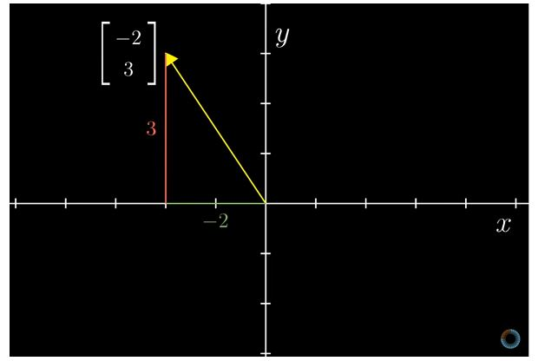
Vector Representations
A 2-dimensional vector can be represented on a 2D plane as follows:

Slide 64
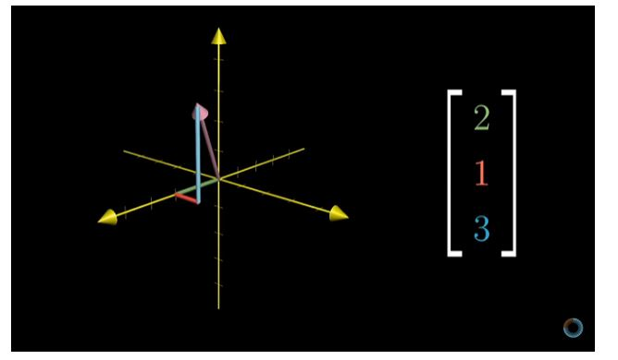
Carrying the idea forward to 3 dimensions, we get an arrow in 3D space as follows:

Slide 65
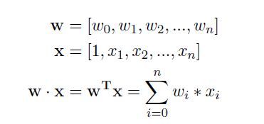
Dot Product Of Two Vectors
Imagine you have two vectors oh size n+1, wand x, the dot product of these vectors (w.x) could be computed as follows:
Here, w and x are just two lonely arrows in an n+1 dimensional space (and intuitively, their dot product quantifies how much one vector is going in the direction of the other).
So technically, the perceptron was only computing a lame dot product (before checking if it's greater or lesser than 0). The decision boundary line which a perceptron gives out that separates positive examples from the negative ones is really just w . x = 0.

Slide 66

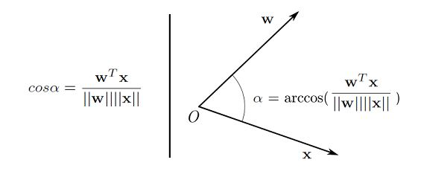
Angle Between Two Vectors
Now the same old dot product can be computed differently if only you knew the angle between the vectors and their individual magnitudes. Here’s how:
The other way around, you can get the angle between two vectors, if only you knew the vectors, given you know how to calculate vector magnitudes and their vanilla dot product.

Slide 67
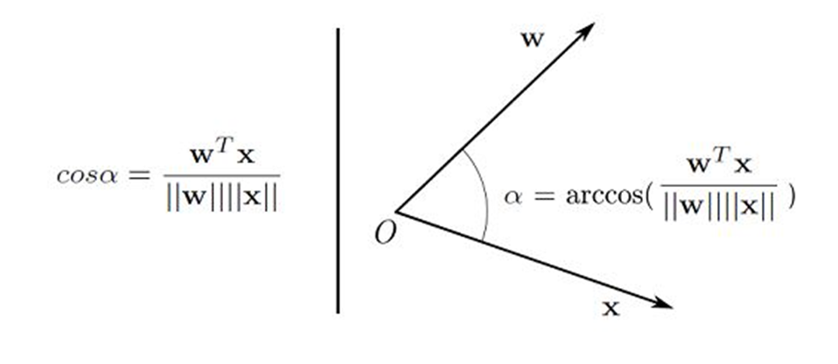
When we say that the cosine of the angle between w and x is 0, we see arrow w being perpendicular to arrow x in an n+1 dimensional space (in 2-dimensional space here). So basically, when the dot product of two vectors is 0, they are perpendicular to each other.

Slide 68
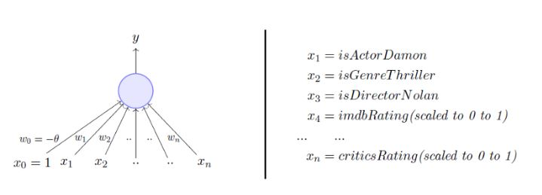
Setting up the problem
Let’s consider our problem to watch a movie or not.

Slide 69
Setting up the problem
Let’s consider our problem to watch a movie or not.
Suppose we are given a list of m movies and a label (class) associated with each movie indicating whether a person liked this movie or not : binary decision. ( Positive or Negative)

Slide 70
Setting up the problem
Let’s consider our problem to watch a movie or not.
Suppose we are given a list of m movies and a label (class) associated with each movie indicating whether a person liked this movie or not : binary decision. ( Positive or Negative)
Further suppose we represent each movie with n features ( some Boolean, some real valued).

Slide 71
Setting up the problem
Let’s consider our problem to watch a movie or not.
Suppose we are given a list of m movies and a label (class) associated with each movie indicating whether a person liked this movie or not : binary decision. ( Positive or Negative)
Further suppose we represent each movie with n features ( some Boolean, some real valued).
We will assume that the data is linearly separable and we want a perceptron to learn how to make this decision.

Slide 72
So if the perceptron has now learnt properly , what would you expect it to do ?

Slide 73
So if the perceptron has now learnt properly , what would you expect it to do ?
So, whenever we feed it, one of the movies, it should give me the same label as was there in our data.

Slide 74
So if the perceptron has now learnt properly , what would you expect it to do ?
So, whenever we feed it, one of the movies, it should give me the same label as was there in our data.
Again there are some movies for which we have a label 1 which are positive and some movies which I have a label 0 . So, I am once again looking to separate the positives from the negatives.

Slide 75
So if the perceptron has now learnt properly , what would you expect it to do ?
So, whenever we feed it, one of the movies, it should give me the same label as was there in our data.
Again there are some movies for which we have a label 1 which are positive and some movies which I have a label 0 . So, I am once again looking to separate the positives from the negatives.
So, it should adjust the weights in such a way that we should be able to separate positives and negatives.

Slide 76
So if the perceptron has now learnt properly , what would you expect it to do ?
So, whenever we feed it, one of the movies, it should give me the same label as was there in our data.
Again there are some movies for which we have a label 1 which are positive and some movies which I have a label 0 . So, I am once again looking to separate the positives from the negatives.
So, it should adjust the weights in such a way that we should be able to separate positives and negatives.
So, that is the learning problem that we are interested in.

Slide 77
So if the perceptron has now learnt properly , what would you expect it to do ?
So, whenever we feed it, one of the movies, it should give me the same label as was there in our data.
Again there are some movies for which we have a label 1 which are positive and some movies which I have a label 0 . So, I am once again looking to separate the positives from the negatives.
So, it should adjust the weights in such a way that we should be able to separate positives and negatives.
So, that is the learning problem that we are interested in.
In other words, we want the perceptron to find the equation of this separating plane ( or find the values of w₀, w₁, w₂,…w_{n}).

Slide 78
Perceptron Learning Algorithm

Slide 79
Perceptron Learning Algorithm
Our goal is to find the w vector that can perfectly classify positive inputs and negative inputs in our data.

Slide 80
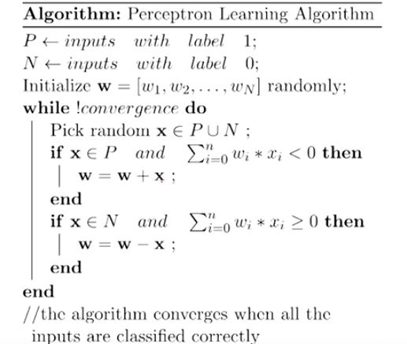
Perceptron Learning Algorithm
Our goal is to find the w vector that can perfectly classify positive inputs and negative inputs in our data.

Slide 81
Perceptron Learning Algorithm
Our goal is to find the w vector that can perfectly classify positive inputs and negative inputs in our data.
We initialize w with some random vector. We then iterate over all the examples in the data, (P U N) both positive and negative examples.

Slide 82
Perceptron Learning Algorithm
Our goal is to find the w vector that can perfectly classify positive inputs and negative inputs in our data.
We initialize w with some random vector. We then iterate over all the examples in the data, (P U N) both positive and negative examples.
Now if an input x belongs to P, ideally what should the dot product w.x be? I’d say greater than or equal to 0 because that’s the only thing what our perceptron wants at the end of the day. And if x belongs to N, the dot product MUST be less than 0. So if you look at the if conditions in the while loop:

Slide 83
Perceptron Learning Algorithm
Our goal is to find the w vector that can perfectly classify positive inputs and negative inputs in our data.
We initialize w with some random vector. We then iterate over all the examples in the data, (P U N) both positive and negative examples.
Now if an input x belongs to P, ideally what should the dot product w.x be? I’d say greater than or equal to 0 because that’s the only thing what our perceptron wants at the end of the day. And if x belongs to N, the dot product MUST be less than 0. So if you look at the if conditions in the while loop:
Case 1: When x belongs to P and its dot product w.x < 0 Case 2: When x belongs to N and its dot product w.x ≥ 0

Slide 84
Perceptron Learning Algorithm
Our goal is to find the w vector that can perfectly classify positive inputs and negative inputs in our data.
We initialize w with some random vector. We then iterate over all the examples in the data, (P U N) both positive and negative examples.
Now if an input x belongs to P, ideally what should the dot product w.x be? I’d say greater than or equal to 0 because that’s the only thing what our perceptron wants at the end of the day. And if x belongs to N, the dot product MUST be less than 0. So if you look at the if conditions in the while loop:
Case 1: When x belongs to P and its dot product w.x < 0 Case 2: When x belongs to N and its dot product w.x ≥ 0
Only for these cases, we are updating our randomly initialized w. Otherwise, we don’t touch w at all because Case 1 and Case 2 are violating the very rule of a perceptron (w.x > 0). So we are adding x to w in Case 1 and subtracting x from w in Case 2.

Slide 85
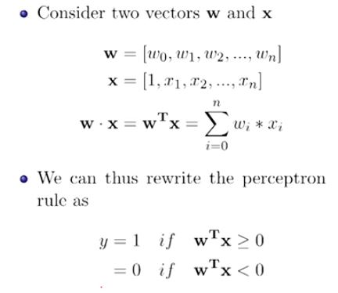
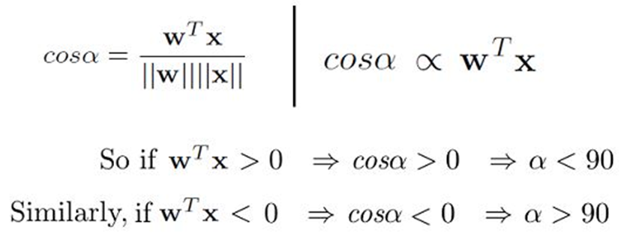
Intuition of why this should work
We are interested in finding the line w^{T}x = 0 which divides the input space into 2 halves..
Every point (x) on this line satisfies the equation w^{T}x = 0
What can you tell about the angle (α) between w and any point (x) which lies on this line?
The angle is 90.
Since the vector w is perpendicular to every point on the line it is actually perpendicular to the line itself.

Slide 86
We have already established that when x belongs to P, we want w.x > 0, basic perceptron rule. What we also mean by that is that when x belongs to P, the angle between w and x should be _____ than 90 degrees. Fill in the blank.

Slide 87
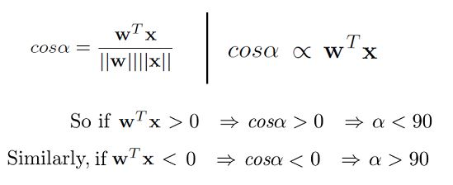
Answer: The angle between w and x should be less than 90 because the cosine of the angle is proportional to the dot product.

Slide 88
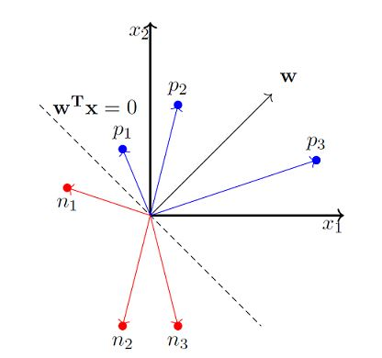
So whatever the w vector may be, as long as it makes an angle less than 90 degrees with the positive example data vectors (x E P) and an angle more than 90 degrees with the negative example data vectors (x E N), we are cool. So ideally, it should look something like this:

Slide 89
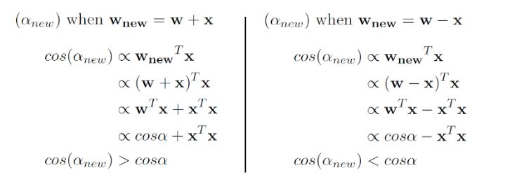
So we now strongly believe that the angle between w and x should be less than 90 when x belongs to P class and the angle between them should be more than 90 when x belongs to N class. Here’s why the update works:

Slide 90
So when we are adding x to w, which we do when x belongs to P and w.x < 0 (Case 1), we are essentially increasing the cos(alpha) value, which means, we are decreasing the alpha value, the angle between w and x, which is what we desire. And the similar intuition works for the case when x belongs to N and w.x ≥ 0 (Case 2).
Here’s a toy simulation of how we might up end up learning w that makes an angle less than 90 for positive examples and more than 90 for negative examples.

Slide 91
Proof Of Convergence
Now, there is no reason for you to believe that this will definitely converge for all kinds of datasets. It seems like there might be a case where the w keeps on moving around and never converges. But people have proved it that this algorithm converges.
Research paper.

Slide 92
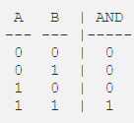
Perceptron Implementing AND
As a refresher, let’s look at the logic table for AND:

Slide 93
Perceptron Implementing AND
As a refresher, let’s look at the logic table for AND:
To produce a logical AND, we want our function to output 1, only when both inputs, A, and B, are also 1. For every other case, our AND should output 0.

Slide 94
Perceptron Implementing AND
As a refresher, let’s look at the logic table for AND:
To produce a logical AND, we want our function to output 1, only when both inputs, A, and B, are also 1. For every other case, our AND should output 0.
Let’s take a look at this using our perceptron model with a few updates:

Slide 95

Perceptron Implementing AND
As a refresher, let’s look at the logic table for AND:
To produce a logical AND, we want our function to output 1, only when both inputs, A, and B, are also 1. For every other case, our AND should output 0.
Let’s take a look at this using our perceptron model with a few updates:
The equation we ended up with looks like this:

Slide 96
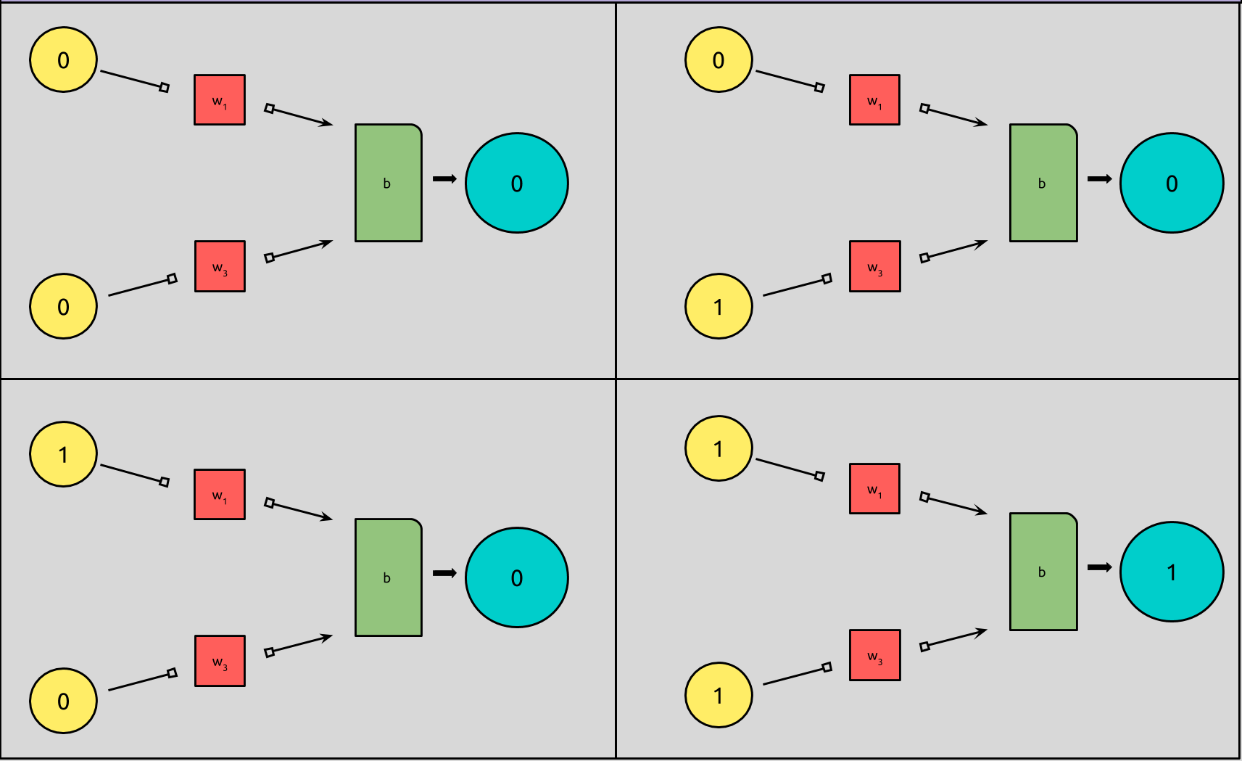
And when we insert our inputs and outputs into our model, it looks like this:

Slide 97
All we’ve done so far, is plug our logic table into our perceptron model. All of our perceptrons are returning 0, except for when both of our inputs are “activated,” i.e. when they are 1.

Slide 98
All we’ve done so far, is plug our logic table into our perceptron model. All of our perceptrons are returning 0, except for when both of our inputs are “activated,” i.e. when they are 1.
What is missing from our model, is the actual implementation detail; the weights and biases that would actually give us our desired output. Moreover, we have four different models to represent each state of our perceptron, when what we really want, is one!

Slide 99
All we’ve done so far, is plug our logic table into our perceptron model. All of our perceptrons are returning 0, except for when both of our inputs are “activated,” i.e. when they are 1.
What is missing from our model, is the actual implementation detail; the weights and biases that would actually give us our desired output. Moreover, we have four different models to represent each state of our perceptron, when what we really want, is one!
So the question becomes how do we represent the behavior of a logical AND, i.e., what weights and biases should we input into our model to produce the desired output?

Slide 100
All we’ve done so far, is plug our logic table into our perceptron model. All of our perceptrons are returning 0, except for when both of our inputs are “activated,” i.e. when they are 1.
What is missing from our model, is the actual implementation detail; the weights and biases that would actually give us our desired output. Moreover, we have four different models to represent each state of our perceptron, when what we really want, is one!
So the question becomes how do we represent the behavior of a logical AND, i.e., what weights and biases should we input into our model to produce the desired output?
First we’ll calculate the weights and biases by hand and then we’ll do it computationally.

Slide 101
The first thing to note is that our weights should be the same for both inputs, A and B.

Slide 102
The first thing to note is that our weights should be the same for both inputs, A and B.
If we look back at our logic chart, we can begin to notice that the position of our input values does not affect our output.

Slide 103
The first thing to note is that our weights should be the same for both inputs, A and B.
If we look back at our logic chart, we can begin to notice that the position of our input values does not affect our output.
For any statement above, if you swap A and B, the AND logic still stands true.

Slide 104
The first thing to note is that our weights should be the same for both inputs, A and B.
If we look back at our logic chart, we can begin to notice that the position of our input values does not affect our output.
For any statement above, if you swap A and B, the AND logic still stands true.
The second thing to note is that our summation + bias, w · x + b, should be negative, except when both A and B are equal to 1.

Slide 105
If we take a look back at our perceptron formula, we can generalize that our neuron will return 1, whenever our input is positive, x > 0, and return 0, otherwise, i.e., when the input is negative or 0.

Slide 106

If we take a look back at our perceptron formula, we can generalize that our neuron will return 1, whenever our input is positive, x > 0, and return 0, otherwise, i.e., when the input is negative or 0.
Now, let’s work our way backwards.
If our inputs are A = 1 and B = 1, we need a positive result from our summation, w · x; for any other inputs, we need a 0 or negative result:

Slide 107

Simplifying, we get

Slide 108
Simplifying, we get
Now we know that:
b is 0 or negative
w + b is 0 or negative
2w + b is positive

Slide 109
Simplifying, we get
Now we know that:
b is 0 or negative
w + b is 0 or negative
2w + b is positive
We also know that:
b cannot be 0. If b = 0, then 2w > 0 and w <= 0, which cannot be true.

Slide 110
Simplifying, we get
Now we know that:
b is 0 or negative
w + b is 0 or negative
2w + b is positive
We also know that:
b cannot be 0. If b = 0, then 2w > 0 and w <= 0, which cannot be true.
w must be positive. If w were negative, any 2w, would also be negative. If 2w were negative, adding another negative number, b, could never result in a positive number, so 2w + b > 0 could never be true.

Slide 111
Simplifying, we get
Now we know that:
b is 0 or negative
w + b is 0 or negative
2w + b is positive
We also know that:
b cannot be 0. If b = 0, then 2w > 0 and w <= 0, which cannot be true.
w must be positive. If w were negative, any 2w, would also be negative. If 2w were negative, adding another negative number, b, could never result in a positive number, so 2w + b > 0 could never be true.
If b is negative and w is positive , w — b = 0, so that w + b <= 0.

Slide 112
We now know that we can set b to any negative number and both w’s to its opposite, and we can reproduce the behavior of AND by using a perceptron!
For simplicity, let’s set b = 1, w1 = -1, and w2 = -1

Slide 113
Even for just a single artificial neuron, with only two binary inputs, a single binary output, and a complete set of training data, that was still a considerable amount of work, which resulted in mimicking behavior of a simple logic statement.

Slide 114
Even for just a single artificial neuron, with only two binary inputs, a single binary output, and a complete set of training data, that was still a considerable amount of work, which resulted in mimicking behavior of a simple logic statement.
If we consider that neural networks are made up of dozens, thousands, or even millions we can see that manually tuning our weights and biases is simply out of the question.

Slide 115
Even for just a single artificial neuron, with only two binary inputs, a single binary output, and a complete set of training data, that was still a considerable amount of work, which resulted in mimicking behavior of a simple logic statement.
If we consider that neural networks are made up of dozens, thousands, or even millions we can see that manually tuning our weights and biases is simply out of the question.
When we talk about a neural network “learning,” or “training,” this tuning process is exactly what we’re talking about. Our networks can learn to assign its own weights and biases, based on a set of training data, where the inputs and expected outputs are known.

Slide 116
Our neuron does this by iterating through training data, and updating the weights and bias after each set of inputs. Once our neuron determines that it has found parameters that successfully classify all of the training data, the learning process is complete, and the weights and biases can then be used to classify data that wasn’t in the training set!

Slide 117
Our neuron does this by iterating through training data, and updating the weights and bias after each set of inputs. Once our neuron determines that it has found parameters that successfully classify all of the training data, the learning process is complete, and the weights and biases can then be used to classify data that wasn’t in the training set!
Seeing that our AND truth table is a type of training data, and we have our model of a network, (even if it’s only one neuron), we can implement this learning behavior.

Slide 118
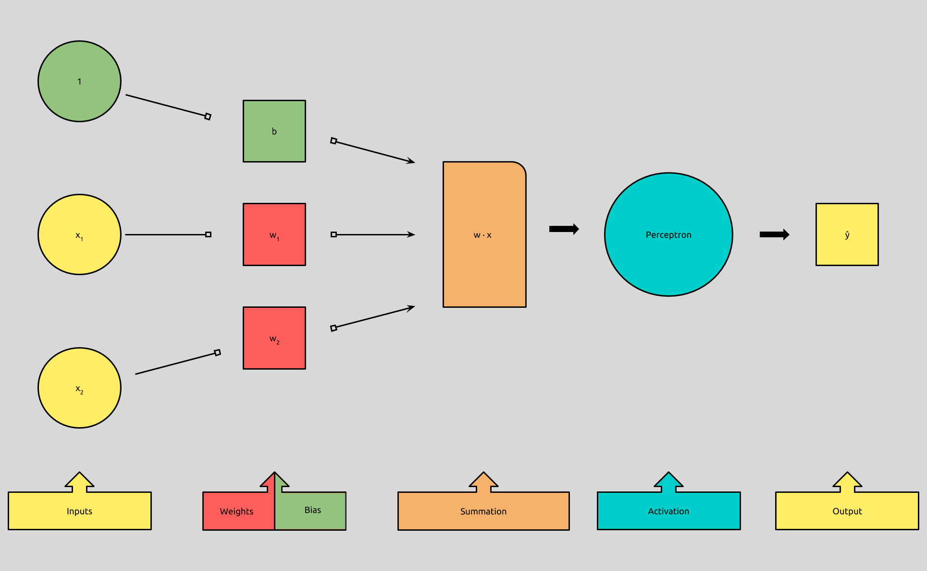
A Bias is the Weight of an Always-Active Input
Before we take a look at the learning process, we’re going to tweak our perceptron model, just a little bit:

Slide 119
It turns out that the algorithm that determines the weights for each input, is the same algorithm that determines the bias. Because of this, it’s more efficient to lump the concept of a bias in with the other inputs by adding an additional input with an activation of 1, and allow our algorithm to treat the weight of that new input, as the bias.

Slide 120
It turns out that the algorithm that determines the weights for each input, is the same algorithm that determines the bias. Because of this, it’s more efficient to lump the concept of a bias in with the other inputs by adding an additional input with an activation of 1, and allow our algorithm to treat the weight of that new input, as the bias.
If you remember our perceptron formula, you’ll recall that we add the dot product of vectors w and x, to the bias, b, to get what is called the weighted sum. Expanded, it looks like this:

Slide 121
We add the product of all n-numbered w's and their n-numbered x's together, and then we add that result to the bias, b.

Slide 122
We add the product of all n-numbered w's and their n-numbered x's together, and then we add that result to the bias, b.
In this equation, we can also represent b, by adding another input whose activation is always 1, and multiplying it by a weight equal to b.

Slide 123
We add the product of all n-numbered w's and their n-numbered x's together, and then we add that result to the bias, b.
In this equation, we can also represent b, by adding another input whose activation is always 1, and multiplying it by a weight equal to b.
You’ll even sometimes see b as (w0 * x0), where x0 = 1.

Slide 124
We add the product of all n-numbered w's and their n-numbered x's together, and then we add that result to the bias, b.
In this equation, we can also represent b, by adding another input whose activation is always 1, and multiplying it by a weight equal to b.
You’ll even sometimes see b as (w0 * x0), where x0 = 1.
Our inputs x ... xn will never be changed by our learning algorithm, and therefore, neither will our new input, 1. Our algorithm now can focus only on adjusting the weights, which now also include our bias.

Slide 125

We can think of this new perceptron algorithm like this:
As long as we explicitly add an input with an activation of 1, and a weight equal to b.

Slide 126
How Perceptrons Learn

Slide 127
How Perceptrons Learn
These are the abstract steps that our perceptron will take in order to learn, i.e., converge on a set of values for its weights that will accurately classify all of our training input:

Slide 128
How Perceptrons Learn
These are the abstract steps that our perceptron will take in order to learn, i.e., converge on a set of values for its weights that will accurately classify all of our training input:
Initialize the weights, sometimes randomly, or more simply, establish them all to 0.

Slide 129
How Perceptrons Learn
These are the abstract steps that our perceptron will take in order to learn, i.e., converge on a set of values for its weights that will accurately classify all of our training input:
Initialize the weights, sometimes randomly, or more simply, establish them all to 0.
For each set of inputs in the set of training examples our perceptron will:

Slide 130
How Perceptrons Learn
These are the abstract steps that our perceptron will take in order to learn, i.e., converge on a set of values for its weights that will accurately classify all of our training input:
Initialize the weights, sometimes randomly, or more simply, establish them all to 0.
For each set of inputs in the set of training examples our perceptron will:
Predict an output

Slide 131
How Perceptrons Learn
These are the abstract steps that our perceptron will take in order to learn, i.e., converge on a set of values for its weights that will accurately classify all of our training input:
Initialize the weights, sometimes randomly, or more simply, establish them all to 0.
For each set of inputs in the set of training examples our perceptron will:
Predict an output
Compare it to the expected output

Slide 132
How Perceptrons Learn
These are the abstract steps that our perceptron will take in order to learn, i.e., converge on a set of values for its weights that will accurately classify all of our training input:
Initialize the weights, sometimes randomly, or more simply, establish them all to 0.
For each set of inputs in the set of training examples our perceptron will:
Predict an output
Compare it to the expected output
Update its weights, if the expected output != the actual output.

Slide 133
How Perceptrons Learn
These are the abstract steps that our perceptron will take in order to learn, i.e., converge on a set of values for its weights that will accurately classify all of our training input:
Initialize the weights, sometimes randomly, or more simply, establish them all to 0.
For each set of inputs in the set of training examples our perceptron will:
Predict an output
Compare it to the expected output
Update its weights, if the expected output != the actual output.
Move to next set of inputs.

Slide 134
There are a few new concepts we’ll want to define.

Slide 135
There are a few new concepts we’ll want to define.
First, we’ll need to know how well our perceptron is doing.

Slide 136

There are a few new concepts we’ll want to define.
First, we’ll need to know how well our perceptron is doing.
Given that our neuron produces an output, and we know what we expect the output to be, we can define how well our neuron is doing like this:

Slide 137
There are a few new concepts we’ll want to define.
First, we’ll need to know how well our perceptron is doing.
Given that our neuron produces an output, and we know what we expect the output to be, we can define how well our neuron is doing like this:
Which we’ll notate like this:
Where e, for error, is equal to our expected output y, minus the output of our perceptron function, f, given inputs x.

Slide 138
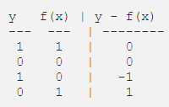
Given that y and f(x) are binary, y — f(x), will produce only one of three values, given any x:

Slide 139
Given that y and f(x) are binary, y — f(x), will produce only one of three values, given any x:
Next, we’ll see how we can use this information to adjust our weights.

Slide 140
Given that y and f(x) are binary, y — f(x), will produce only one of three values, given any x:
Next, we’ll see how we can use this information to adjust our weights.
The goal: get y — f(x) closer to 0.

Slide 141
Given that y and f(x) are binary, y — f(x), will produce only one of three values, given any x:
Next, we’ll see how we can use this information to adjust our weights.
The goal: get y — f(x) closer to 0.
The intuition behind this learning algorithm, developed by Frank Rosenblatt, who you’ll remember as the creator as the perceptron, follows a simple rule:

Slide 142
If the neuron activates, when we want it not, suppress it.

Slide 143
If the neuron activates, when we want it not, suppress it.
If the neuron does not activate, when we want it so, excite it.

Slide 144
If the neuron activates, when we want it not, suppress it.
If the neuron does not activate, when we want it so, excite it.
If the neuron performs as asked, do nothing.
!(Frank Rosenblatt)
.

Slide 145
If the neuron activates, when we want it not, suppress it.
If the neuron does not activate, when we want it so, excite it.
If the neuron performs as asked, do nothing.
!(Frank Rosenblatt)
We know how to check how well our neuron is doing, so now, we’ll need to establish how we can excite it, suppress it, or do nothing to it.

Slide 146
If the neuron activates, when we want it not, suppress it.
If the neuron does not activate, when we want it so, excite it.
If the neuron performs as asked, do nothing.
!(Frank Rosenblatt)
We know how to check how well our neuron is doing, so now, we’ll need to establish how we can excite it, suppress it, or do nothing to it.
If the perceptron outputs 1, (f(x) = 1), when we wanted 0, (y = 0), we’ll want to adjust it by making w · x smaller, because in order to get f(x) = 0, w · x must be <= 0.

Slide 147
If the neuron activates, when we want it not, suppress it.
If the neuron does not activate, when we want it so, excite it.
If the neuron performs as asked, do nothing.
!(Frank Rosenblatt)
We know how to check how well our neuron is doing, so now, we’ll need to establish how we can excite it, suppress it, or do nothing to it.
If the perceptron outputs 1, (f(x) = 1), when we wanted 0, (y = 0), we’ll want to adjust it by making w · x smaller, because in order to get f(x) = 0, w · x must be <= 0.
Likewise, if the perceptron outputs 0, (f(x) = 0), when we wanted 1, (y = 1), we’ll want to adjust it by making w · x larger, because in order to get f(x) = 1, w · x must be > 0.

Slide 148
If the neuron activates, when we want it not, suppress it.
If the neuron does not activate, when we want it so, excite it.
If the neuron performs as asked, do nothing.
!(Frank Rosenblatt)
We know how to check how well our neuron is doing, so now, we’ll need to establish how we can excite it, suppress it, or do nothing to it.
If the perceptron outputs 1, (f(x) = 1), when we wanted 0, (y = 0), we’ll want to adjust it by making w · x smaller, because in order to get f(x) = 0, w · x must be <= 0.
Likewise, if the perceptron outputs 0, (f(x) = 0), when we wanted 1, (y = 1), we’ll want to adjust it by making w · x larger, because in order to get f(x) = 1, w · x must be > 0.
And finally, if the perceptron outputs what we expected, f(x) == y, we’ll want to adjust nothing, because our perceptron has successfully classified our input!
.

Slide 149
If the neuron activates, when we want it not, suppress it.
If the neuron does not activate, when we want it so, excite it.
If the neuron performs as asked, do nothing.
!(Frank Rosenblatt)
We know how to check how well our neuron is doing, so now, we’ll need to establish how we can excite it, suppress it, or do nothing to it.
If the perceptron outputs 1, (f(x) = 1), when we wanted 0, (y = 0), we’ll want to adjust it by making w · x smaller, because in order to get f(x) = 0, w · x must be <= 0.
Likewise, if the perceptron outputs 0, (f(x) = 0), when we wanted 1, (y = 1), we’ll want to adjust it by making w · x larger, because in order to get f(x) = 1, w · x must be > 0.
And finally, if the perceptron outputs what we expected, f(x) == y, we’ll want to adjust nothing, because our perceptron has successfully classified our input!
Again, for each input, we go through these adjustments, and then blindly move to the next set of inputs.

Slide 150

Lastly, let’s look at how we’ll make these adjustments our weights.
We can’t change our x, but we can change our w, and here is the formula for doing so:

Slide 151
Lastly, let’s look at how we’ll make these adjustments our weights.
We can’t change our x, but we can change our w, and here is the formula for doing so:
So, to make our w larger or smaller, we simply add or subtract x to it.
Because our y — f(x) produces 1, -1, and 0, we can simplify:

Slide 152
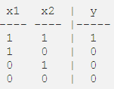
Let’s see how this works with the first iteration by training AND:
Training data:

Slide 153
Let’s see how this works with the first iteration by training AND:
Training data:
1. Initialize the weights, sometimes randomly, or more simply, establish them all to 0.

Slide 154

2. For each set of inputs in the set of training examples our perceptron will:

Slide 155
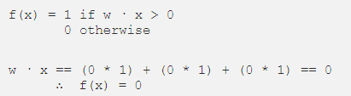
2. For each set of inputs in the set of training examples our perceptron will:
3. Predict an output

Slide 156

2. For each set of inputs in the set of training examples our perceptron will:
3. Predict an output
4. Compare it to the expected output

Slide 157
5. Update its weights, if the expected output != the actual output
6. Move to next set of inputs.

Slide 158
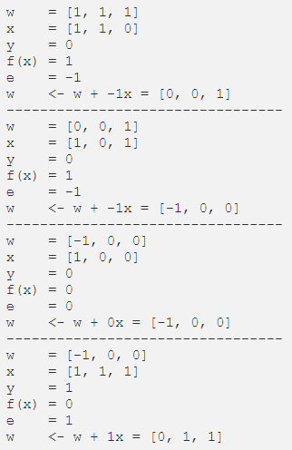
Now I’ll speed through the rest of the iterations, so that you can see the algorithm in action.

Slide 159
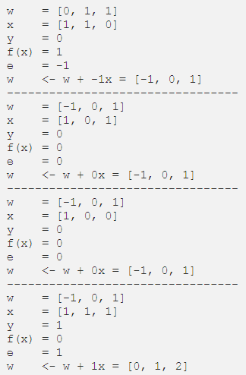
Now I’ll speed through the rest of the iterations, so that you can see the algorithm in action.

Slide 160
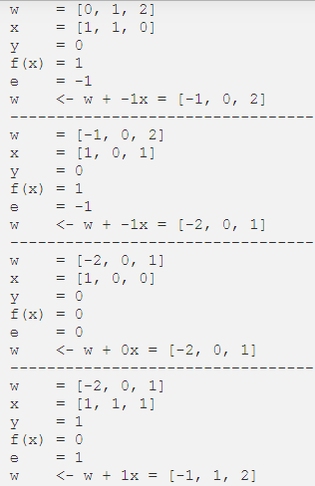
Now I’ll speed through the rest of the iterations, so that you can see the algorithm in action.

Slide 161
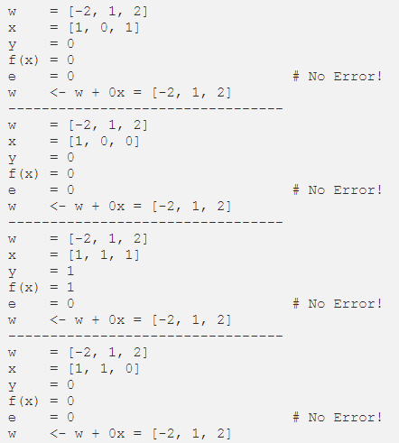

Slide 162

Wrap up
Those are our two formulas to describe perceptrons and our learning rule.

Slide 163
Wrap up
Those are our two formulas to describe perceptrons and our learning rule.
We ended up finding different weights (and pseudo-bias) than last time, when we simply reasoned about a solution. This was solved algorithmically, and is something a computer could do!

Slide 164
There Are a Few Concepts Missing
Three concepts in particular that are missing from our training algorithm are epoch, threshold, and learning rate.

Slide 165
There Are a Few Concepts Missing
Three concepts in particular that are missing from our training algorithm are epoch, threshold, and learning rate.
Epoch is the number of times we’ve iterated through the entire training set. So for the example above, during epoch = 5, we were able to establish weights to classify all of our inputs, but we continued iterating, to be sure that our weights were tried on all of our inputs.

Slide 166
There Are a Few Concepts Missing
Three concepts in particular that are missing from our training algorithm are epoch, threshold, and learning rate.
Epoch is the number of times we’ve iterated through the entire training set. So for the example above, during epoch = 5, we were able to establish weights to classify all of our inputs, but we continued iterating, to be sure that our weights were tried on all of our inputs.
Threshold is different than what we now call our bias. Threshold is the maximum number of epoch we will allow to pass while training. There is not built in stopping point of our algorithm. It will continue adding 0 to our weights, on and on, forever. Adding a threshold is one way of stopping our training loop.

Slide 167
There Are a Few Concepts Missing
Three concepts in particular that are missing from our training algorithm are epoch, threshold, and learning rate.
Epoch is the number of times we’ve iterated through the entire training set. So for the example above, during epoch = 5, we were able to establish weights to classify all of our inputs, but we continued iterating, to be sure that our weights were tried on all of our inputs.
Threshold is different than what we now call our bias. Threshold is the maximum number of epoch we will allow to pass while training. There is not built in stopping point of our algorithm. It will continue adding 0 to our weights, on and on, forever. Adding a threshold is one way of stopping our training loop.
Learning rate, symbolize by α, is the magnitude at which we increase or decrease our weights during each iteration of training:

Slide 168
In Summary, we now have in our arsenal a classification algorithm.

Slide 169
In Summary, we now have in our arsenal a classification algorithm.
Classification is a subcategory of supervised learning where the goal is to predict the categorical class labels of new instances, based on past observations.

Slide 170
In Summary, we now have in our arsenal a classification algorithm.
Classification is a subcategory of supervised learning where the goal is to predict the categorical class labels of new instances, based on past observations.
Supervised learning, is a subcategory of Machine Learning, where learning data is labeled, meaning that for each of the examples used to train the perceptron, the output in known in advanced.

Slide 171
In Summary, we now have in our arsenal a classification algorithm.
Classification is a subcategory of supervised learning where the goal is to predict the categorical class labels of new instances, based on past observations.
Supervised learning, is a subcategory of Machine Learning, where learning data is labeled, meaning that for each of the examples used to train the perceptron, the output in known in advanced.
When considering what kinds of problems a perceptron is useful for, we can determine that it’s good for tasks where we want to predict if an input belongs in one of two categories, based on it’s features and the features of inputs that are known to belong to one of those two categories.

Slide 172
In Summary, we now have in our arsenal a classification algorithm.
Classification is a subcategory of supervised learning where the goal is to predict the categorical class labels of new instances, based on past observations.
Supervised learning, is a subcategory of Machine Learning, where learning data is labeled, meaning that for each of the examples used to train the perceptron, the output in known in advanced.
When considering what kinds of problems a perceptron is useful for, we can determine that it’s good for tasks where we want to predict if an input belongs in one of two categories, based on it’s features and the features of inputs that are known to belong to one of those two categories.
These tasks are called binary classification tasks. Real-world examples include email spam filtering, search result indexing, medical evaluations, financial predictions, and, well, almost anything that is “binarily classifiable.”

Slide 173
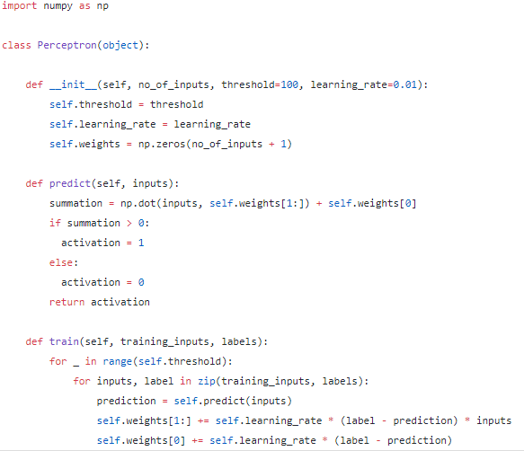
The code

Slide 174

Line-by-Line
1.
We’re using numpy module to evaluate our dot product w · x during our summation. numpy lets us create vectors, and gives us both linear algebra functions and python list-like methods to use with it. We access its functions by calling them on np.

Slide 175

Line-by-Line
1.
We’re using numpy module to evaluate our dot product w · x during our summation. numpy lets us create vectors, and gives us both linear algebra functions and python list-like methods to use with it. We access its functions by calling them on np.
2.
Here, we’re creating a new class Perceptron. This will, among other things, allow us to maintain state in order to use our perceptron after it has learned and assigned values to its weights.

Slide 176
3.
In our constructor, we accept a few parameters that represent concepts that we have looked.

Slide 177
3.
In our constructor, we accept a few parameters that represent concepts that we have looked.
The no_of_inputs is used to determine how many weights we need to learn.

Slide 178
3.
In our constructor, we accept a few parameters that represent concepts that we have looked.
The no_of_inputs is used to determine how many weights we need to learn.
The threshold, is the number of epochs we’ll allow our learning algorithm to iterate through before ending, and it’s defaulted to 100.

Slide 179
3.
In our constructor, we accept a few parameters that represent concepts that we have looked.
The no_of_inputs is used to determine how many weights we need to learn.
The threshold, is the number of epochs we’ll allow our learning algorithm to iterate through before ending, and it’s defaulted to 100.
The learning_rate is used to determine the magnitude of change for our weights during each step through our training data, and is defaulted to 0.01.

Slide 180
3.
In our constructor, we accept a few parameters that represent concepts that we have looked.
The no_of_inputs is used to determine how many weights we need to learn.
The threshold, is the number of epochs we’ll allow our learning algorithm to iterate through before ending, and it’s defaulted to 100.
The learning_rate is used to determine the magnitude of change for our weights during each step through our training data, and is defaulted to 0.01.
The threshold and learning_rate variables can be played with to alter the efficiency of our perceptron learning rule, because of that, I’ve decided to make them optional parameters, so that they can be experimented with at runtime.

Slide 181

4.
These two lines set the threshold and learning_rate arguments to instance variables.

Slide 182
4.
These two lines set the threshold and learning_rate arguments to instance variables.
5.
Here, we initialize our weight vector. np.zeros(n), will create a vector with an n-number of 0’s. Here, we use the no_of_inputs, (which again, is number of inputs in our input vector, x), plus 1.

Slide 183
4.
These two lines set the threshold and learning_rate arguments to instance variables.
5.
Here, we initialize our weight vector. np.zeros(n), will create a vector with an n-number of 0’s. Here, we use the no_of_inputs, (which again, is number of inputs in our input vector, x), plus 1.
Remember, we moved our bias into the weight vector, so that we didn’t have to deal with it independently of our other weights? This bias is the +1 to our weight vector, and is referred to as the bias weight.

Slide 184
4.
These two lines set the threshold and learning_rate arguments to instance variables.
5.
Here, we initialize our weight vector. np.zeros(n), will create a vector with an n-number of 0’s. Here, we use the no_of_inputs, (which again, is number of inputs in our input vector, x), plus 1.
Remember, we moved our bias into the weight vector, so that we didn’t have to deal with it independently of our other weights? This bias is the +1 to our weight vector, and is referred to as the bias weight.
6.
Now, we define our predict method. This method will house the f(x) = 1 if w · x + b > 0 : 0 otherwise algorithm.
The predict method takes one argument, inputs, which it expects to be an numpy array/vector of a dimension equal to the no_of_inputs parameter that the perceptron was initialized with on line 5.

Slide 185
7.

Slide 186
7.
This is where the numpy dot product function comes in, and it works exactly how you might expect. np.dot(a, b) == a · b. It’s important to remember that dot products only work if both vectors are of equal dimension. [1, 2, 3] · [1, 2, 3, 4] is invalid. Things get a bit tricky here because we’ve added an extra dimension to our self.weights vector to act as the bias.

Slide 187
7.
This is where the numpy dot product function comes in, and it works exactly how you might expect. np.dot(a, b) == a · b. It’s important to remember that dot products only work if both vectors are of equal dimension. [1, 2, 3] · [1, 2, 3, 4] is invalid. Things get a bit tricky here because we’ve added an extra dimension to our self.weights vector to act as the bias.
There are two options here, either we can add a 1 to the beginning of our inputs vector or, we can take the dot product of the inputs and the self.weights vector with the the first value “removed”, and then add the first value of the self.weights vector to the dot product. Either way works, I just happened to think that this way was cleaner.

Slide 188
7.
This is where the numpy dot product function comes in, and it works exactly how you might expect. np.dot(a, b) == a · b. It’s important to remember that dot products only work if both vectors are of equal dimension. [1, 2, 3] · [1, 2, 3, 4] is invalid. Things get a bit tricky here because we’ve added an extra dimension to our self.weights vector to act as the bias.
There are two options here, either we can add a 1 to the beginning of our inputs vector or, we can take the dot product of the inputs and the self.weights vector with the the first value “removed”, and then add the first value of the self.weights vector to the dot product. Either way works, I just happened to think that this way was cleaner.
.
We then store the result in the variable, summation.

Slide 189
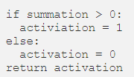
8.

Slide 190
8.
This is our step function. It kind of reads like pseudo code: if the summation from above is greater than 0, we store 1 in the variable activation, otherwise, activation = 0, then we return that value.
We don’t need the temporary variable activation, but for now, the goal is to be explicit.

Slide 191
9.

Slide 192
9.
Next, we define the train method, which takes two arguments: training_inputs and labels.

Slide 193
9.
Next, we define the train method, which takes two arguments: training_inputs and labels.
training_inputs is expected to be a list made up of numpy vectors to be used as inputs by the predict method.

Slide 194
9.
Next, we define the train method, which takes two arguments: training_inputs and labels.
training_inputs is expected to be a list made up of numpy vectors to be used as inputs by the predict method.
labels is expected to be a numpy array of expected output values for each of the corresponding inputs in the training_inputs list.

Slide 195
9.
Next, we define the train method, which takes two arguments: training_inputs and labels.
training_inputs is expected to be a list made up of numpy vectors to be used as inputs by the predict method.
labels is expected to be a numpy array of expected output values for each of the corresponding inputs in the training_inputs list.
In essence, the input vector at training_inputs[n] has the expected output at labels[n], therefore len(training_inputs) == len(labels).

Slide 196

10.
This creates a loop wherein the following code block will be run a number of times equal to the threshold argument we passed into the Perceptron constructor. If one hasn’t been passed in, it’s defaulted to 100 epochs. Because we don’t care to use an iterator variable, convention has us set it to _.

Slide 197
11.
There are three important steps happening in this line:

Slide 198
11.
There are three important steps happening in this line:
We zip training_inputs and labels together to create a new iterable object

Slide 199
11.
There are three important steps happening in this line:
We zip training_inputs and labels together to create a new iterable object
We loop through the new object

Slide 200
11.
There are three important steps happening in this line:
We zip training_inputs and labels together to create a new iterable object
We loop through the new object
While we iterate through, we store each elements in the training_inputs list into the inputs variable, and each of the elements in labels, in the variable label.

Slide 201
11.
There are three important steps happening in this line:
We zip training_inputs and labels together to create a new iterable object
We loop through the new object
While we iterate through, we store each elements in the training_inputs list into the inputs variable, and each of the elements in labels, in the variable label.
In the code block after this line, when we reference label, we get the expected output of the input vector stored in the inputs variable, and we do this once for every inputs/label pair.

Slide 202

12.
Here, we pass the inputs vector into our previously defined predict method, and we store the result in the prediction variable.

Slide 203
12.
Here, we pass the inputs vector into our previously defined predict method, and we store the result in the prediction variable.
13.

Slide 204
12.
Here, we pass the inputs vector into our previously defined predict method, and we store the result in the prediction variable.
13.
This is almost all of the learning rule implementation:

Slide 205
12.
Here, we pass the inputs vector into our previously defined predict method, and we store the result in the prediction variable.
13.
This is almost all of the learning rule implementation:

Slide 206
12.
Here, we pass the inputs vector into our previously defined predict method, and we store the result in the prediction variable.
13.
This is almost all of the learning rule implementation:
We find the error, label — prediction, then we multiply it by our self.learning_rate, and by our inputs vector, we then add that result to the weight vector (with the bias weight removed), and store it back into self.weights[1:].

Slide 207
Remember that self.weights[0] is our bias weight, so we can’t add self.weights and inputs vectors directly, as they’re of different dimensions.

Slide 208
Remember that self.weights[0] is our bias weight, so we can’t add self.weights and inputs vectors directly, as they’re of different dimensions.
There were several options to take care of this, but I think the most explicit was is to mimic what we have done early, by only considering the vector created by “removing” the bias weight at self.weights[0].

Slide 209
Remember that self.weights[0] is our bias weight, so we can’t add self.weights and inputs vectors directly, as they’re of different dimensions.
There were several options to take care of this, but I think the most explicit was is to mimic what we have done early, by only considering the vector created by “removing” the bias weight at self.weights[0].
We can’t just ignore the bias, so we deal with it next:

Slide 210
Remember that self.weights[0] is our bias weight, so we can’t add self.weights and inputs vectors directly, as they’re of different dimensions.
There were several options to take care of this, but I think the most explicit was is to mimic what we have done early, by only considering the vector created by “removing” the bias weight at self.weights[0].
We can’t just ignore the bias, so we deal with it next:
We update the bias in the same way as the other weights, except, we don’t multiply it by the inputs vector.

Slide 211

Usage
Let’s put it to work and finally wrap up implementing AND

Slide 212
Summary
The perceptron classifies inputs by finding the dot product of an input feature vector and weight vector and passing that number into a step function, which will return 1 for numbers greater than 0, or 0 otherwise.

Slide 213
Summary
The perceptron classifies inputs by finding the dot product of an input feature vector and weight vector and passing that number into a step function, which will return 1 for numbers greater than 0, or 0 otherwise.
In order to the determine the weights, the Perceptron Learning Rule:

Slide 214
Summary
The perceptron classifies inputs by finding the dot product of an input feature vector and weight vector and passing that number into a step function, which will return 1 for numbers greater than 0, or 0 otherwise.
In order to the determine the weights, the Perceptron Learning Rule:
Predicts an output based on the current weights and inputs

Slide 215
Summary
The perceptron classifies inputs by finding the dot product of an input feature vector and weight vector and passing that number into a step function, which will return 1 for numbers greater than 0, or 0 otherwise.
In order to the determine the weights, the Perceptron Learning Rule:
Predicts an output based on the current weights and inputs
Compares it to the expected output, or label

Slide 216
Summary
The perceptron classifies inputs by finding the dot product of an input feature vector and weight vector and passing that number into a step function, which will return 1 for numbers greater than 0, or 0 otherwise.
In order to the determine the weights, the Perceptron Learning Rule:
Predicts an output based on the current weights and inputs
Compares it to the expected output, or label
Update its weights, if the prediction != the label

Slide 217
Summary
The perceptron classifies inputs by finding the dot product of an input feature vector and weight vector and passing that number into a step function, which will return 1 for numbers greater than 0, or 0 otherwise.
In order to the determine the weights, the Perceptron Learning Rule:
Predicts an output based on the current weights and inputs
Compares it to the expected output, or label
Update its weights, if the prediction != the label
Iterate until the epoch threshold has been reached

Slide 218
To update the weights during each iteration, it:
Finds the error by subtracting the prediction from the label
Multiplies the error and the learning rate
Multiplies the result to the inputs
Adds the resulting vector to the weight vector

Slide 219

XOR Function using a Perceptron
It is non-linear Boolean function i.e., you cannot draw a line to separate positive inputs from the negative ones.
Notice that the fourth equation contradicts the second and the third equation. Point is, there are no perceptron solutions for non-linearly separated data. So the key take away is that a single perceptron cannot learn to separate the data that are non-linear in nature.

Slide 220

Some non-linear data
Most real world data is not linearly separable and will always contain some outliers.
In fact, sometimes there may not be any outliers but still the data may not be linearly separable.
While a single perceptron cannot deal with such data, we will show that a network of Perceptrons can indeed deal with such data.
In the book published by Minsky and Papert in 1969, the authors implied that, since a single artificial neuron is incapable of implementing some functions such as the XOR logical function, larger networks also have similar limitations, and therefore should be dropped. Later research on three-layered Perceptrons showed how to implement such functions, therefore saving the technique from obliteration.

Slide 221

Network of Perceptrons
For this example assume True = +1 and False = -1.
We consider 2 inputs and 4 perceptrons.
Each input is connected to all the 4 perceptrons with specific weights.
The bias (w₀) of each perceptron is -2 (i.e. each perceptron will fire only if the weighted sum of its inputs is >= 2)
Each of these perceptrons is connected to an output perceptron by weights (which need to be learned)
The output of this perceptron (y) is the output of this network.
Red edges indicate w = -1
Blue edges indicate w = +1

Slide 222

Terminology
This network contains 3 layers.
The layer containing inputs (x₁, x₂) is called the input layer.
The middle layer containing the 4 perceptrons is called the hidden layer.
The final layer containing one output neuron is called the output layer.
The outputs of the 4 perceptrons in the hidden layer are denoted by h₁, h₂, h₃, h_{4.}
The red and blue edges are called layer 1 weights.
w₁, w₂, w₃, w₄ are called layer 2 weights.
Red edges indicate w = -1
Blue edges indicate w = +1

Slide 223

We claim that this network can be used to implement any Boolean function (linearly separable or not)
Red edges indicate w = -1
Blue edges indicate w = +1

Slide 224
We claim that this network can be used to implement any Boolean function (linearly separable or not)
In other words, we can find w1, w2, w3, w4 such that the truth table of any Boolean function can be represented by this network.
Red edges indicate w = -1
Blue edges indicate w = +1

Slide 225
We claim that this network can be used to implement any Boolean function (linearly separable or not)
In other words, we can find w1, w2, w3, w4 such that the truth table of any Boolean function can be represented by this network.
Each perceptron in the middle layers fires only for a specific input (and no two perceptrons fire for the same input)
Red edges indicate w = -1
Blue edges indicate w = +1

Slide 226
We claim that this network can be used to implement any Boolean function (linearly separable or not)
In other words, we can find w1, w2, w3, w4 such that the truth table of any Boolean function can be represented by this network.
Each perceptron in the middle layers fires only for a specific input (and no two perceptrons fire for the same input)
Let us see why this network works by taking an example of the XOR function.
Red edges indicate w = -1
Blue edges indicate w = +1

Slide 227


XOR using Network of Perceptrons
Let w₀ be the bias output of the neuron. (i.e. it will fire if ∑ w_{i}h_{i} >= w₀)
Red edges indicate w = -1
Blue edges indicate w = +1

Slide 228
XOR using Network of Perceptrons
Let w₀ be the bias output of the neuron. (i.e. it will fire if ∑ w_{i}h_{i} >= w₀)
This results in the following 4 conditions to implement XOR : w₁ < w₀, w₂ ≥ w₀, w₃ ≥ w₀, w₄ < w₀.
Red edges indicate w = -1
Blue edges indicate w = +1

Slide 229
XOR using Network of Perceptrons
Let w₀ be the bias output of the neuron. (i.e. it will fire if ∑ w_{i}h_{i} >= w₀)
This results in the following 4 conditions to implement XOR : w₁ < w₀, w₂ ≥ w₀, w₃ ≥ w₀, w₄ < w₀.
Unlike before, there are no contradictions now and the system of inequalities can be satisfied.
Red edges indicate w = -1
Blue edges indicate w = +1

Slide 230
XOR using Network of Perceptrons
Let w₀ be the bias output of the neuron. (i.e. it will fire if ∑ w_{i}h_{i} >= w₀)
This results in the following 4 conditions to implement XOR : w₁ < w₀, w₂ ≥ w₀, w₃ ≥ w₀, w₄ < w₀.
Unlike before, there are no contradictions now and the system of inequalities can be satisfied.
Essentially each w_{i} is now responsible for one of the 4 possible inputs and can be adjusted to get the desired output for that input.
Red edges indicate w = -1
Blue edges indicate w = +1

Slide 231
What if we have more than 3 inputs?

Slide 232

Again each of the 8 perceptrons will fire only for one of the 8 inputs.
Each of the 8 weights in the second layer is responsible for one of the 8 inputs and can be adjusted to produce the desired output for that input.

Slide 233
Theorem:
Any Boolean function of n inputs can be represented by a network of perceptrons containing 1 hidden layer with 2^{n} perceptrons and one output layer containing 1 perceptron.

Slide 234

How does this relate to our original problem of movie classification?
Now what the previous theorem told us is that irrespective of whether our data is linearly separable or not, we can make a network which will be able to solve this problem and that it might be very expensive in the number of neurons in the middle.

Slide 235
How does this relate to our original problem of movie classification?
Now what the previous theorem told us is that irrespective of whether our data is linearly separable or not, we can make a network which will be able to solve this problem and that it might be very expensive in the number of neurons in the middle.
But if you keep that aside, we have a solution for this. And that is why we care about Boolean functions, because we could actually cast many problems in a simplistic way, if we ignore the real inputs.

Slide 236
How does this relate to our original problem of movie classification?
Now what the previous theorem told us is that irrespective of whether our data is linearly separable or not, we can make a network which will be able to solve this problem and that it might be very expensive in the number of neurons in the middle.
But if you keep that aside, we have a solution for this. And that is why we care about Boolean functions, because we could actually cast many problems in a simplistic way, if we ignore the real inputs.
And if you even think of the real inputs, Suppose it could take all values between 0 to 1, you can always make it binary, you could say that is the value between 0 and 0.1 and the value between 0.1 and 0.2. And you could make the scale as small as possible right. So, that is why we care about this.

Slide 237
Summary so far
Networks of the form that we just saw ( containing an input, output and one or more hidden layers) are called Multilayer Perceptrons (MLP).

Slide 238
Summary so far
Networks of the form that we just saw ( containing an input, output and one or more hidden layers) are called Multilayer Perceptrons (MLP).
More appropriate terminology would be “ Multilayered network of perceptrons ” but MLP is the more commonly used name.

Slide 239
Summary so far
Networks of the form that we just saw ( containing an input, output and one or more hidden layers) are called Multilayer Perceptrons (MLP).
More appropriate terminology would be “ Multilayered network of perceptrons ” but MLP is the more commonly used name.
The theorem that we just saw gives us the representation power of a MLP with a single hidden layer.

Slide 240
Summary so far
Networks of the form that we just saw ( containing an input, output and one or more hidden layers) are called Multilayer Perceptrons (MLP).
More appropriate terminology would be “ Multilayered network of perceptrons ” but MLP is the more commonly used name.
The theorem that we just saw gives us the representation power of a MLP with a single hidden layer.
Specifically, it tells us that a MLP with a single hidden layer can represent any Boolean function.

Slide 241
Sigmoid neurons
The artificial neurons we use today are slightly different from the perceptron we looked at, the difference is the Activation function.

Slide 242

Sigmoid neurons
The artificial neurons we use today are slightly different from the perceptron we looked at, the difference is the Activation function.
Some might say that the thresholding logic used by a perceptron is very harsh. For example, if you look at a problem of deciding if I will be watching a movie or not, based only on one real-valued input (x₁ = criticsRating) and if the threshold we set is 0.5 (w₀ = -0.5) and w₁= 1 then our setup would look like this:

Slide 243

What would be the decision for a movie with criticsRating = 0.51? Yes!

Slide 244
What would be the decision for a movie with criticsRating = 0.51? Yes!
What would be the decision for a movie with criticsRating = 0.49? No!
.

Slide 245
What would be the decision for a movie with criticsRating = 0.51? Yes!
What would be the decision for a movie with criticsRating = 0.49? No!
Some might say that its harsh that we would watch a movie with a rating of 0.51 but not the one with a rating of 0.49 and this is where Sigmoid comes into the picture.

Slide 246
What would be the decision for a movie with criticsRating = 0.51? Yes!
What would be the decision for a movie with criticsRating = 0.49? No!
Some might say that its harsh that we would watch a movie with a rating of 0.51 but not the one with a rating of 0.49 and this is where Sigmoid comes into the picture.
Now convince yourself that this harsh thresholding is not attributed to just one specific problem we chose here, it could happen with any or every problem we deal with. It is a characteristic of the perceptron function itself which behaves like a step function.

Slide 247
There will be this sudden change in the decision (from 0 to 1) when z value crosses the threshold (-w₀). For most real-world applications we would expect a smoother decision function which gradually changes from 0 to 1.

Slide 248
There will be this sudden change in the decision (from 0 to 1) when z value crosses the threshold (-w₀). For most real-world applications we would expect a smoother decision function which gradually changes from 0 to 1.
Introducing sigmoid neurons where the output function is much smoother than the step function seems like a logical and obvious thing to do.

Slide 249
There will be this sudden change in the decision (from 0 to 1) when z value crosses the threshold (-w₀). For most real-world applications we would expect a smoother decision function which gradually changes from 0 to 1.
Introducing sigmoid neurons where the output function is much smoother than the step function seems like a logical and obvious thing to do.
A sigmoid function is a mathematical function with a characteristic “S”-shaped curve, also called the sigmoid curve. There are many functions that can do the job for you, some are shown below:

Slide 250

There will be this sudden change in the decision (from 0 to 1) when z value crosses the threshold (-w₀). For most real-world applications we would expect a smoother decision function which gradually changes from 0 to 1.
Introducing sigmoid neurons where the output function is much smoother than the step function seems like a logical and obvious thing to do.
A sigmoid function is a mathematical function with a characteristic “S”-shaped curve, also called the sigmoid curve. There are many functions that can do the job for you, some are shown below:

Slide 251
One of the simplest one to work with is the logistic function.

Slide 252

One of the simplest one to work with is the logistic function.

Slide 253
One of the simplest one to work with is the logistic function.
We no longer see a sharp transition around the w₀. Also, the output is no longer binary but a real value between 0 and 1 which can be interpreted as a probability. So instead of yes/no decision, we get the probability of yes.

Slide 254
One of the simplest one to work with is the logistic function.
We no longer see a sharp transition around the w₀. Also, the output is no longer binary but a real value between 0 and 1 which can be interpreted as a probability. So instead of yes/no decision, we get the probability of yes.
The output here is smooth, continuous and differentiable and just how any learning algorithm likes it. (Backprop)

Slide 255


Slide 256
Watch Khan academy videos of multivariable calculus. (Gradient part)

